Slide 1


Formula 1 Lap Time Prediction
Optimization Project
Optimization
2024/2025
PRESENTER
Daniele Gotti - 1079011
LOCATION
Dalmine, BG

Slide 2
What is Formula 1?

Slide 3

What is Formula 1?
Formula 1 (F1) is the highest class of international motorsport.
It features open-wheel, single-seater race cars competing in a series of Grand Prix events worldwide.
Each Grand Prix (24 GPs in 2025) is held on a permanent or street circuit in different countries and the race weekend usually spans three days.
Source: sportingnews.com

Slide 4
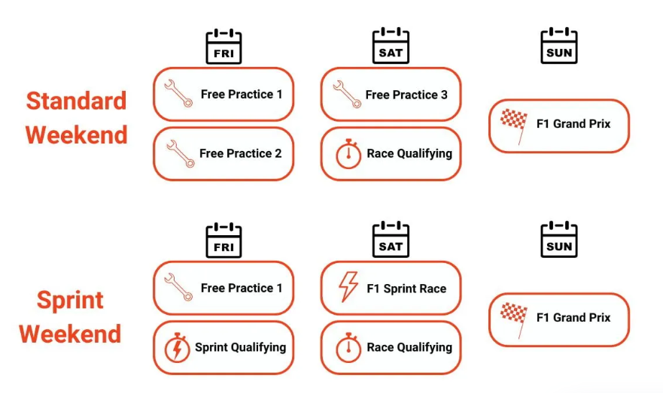
Race weekend
Source: fanamp.com

Slide 5

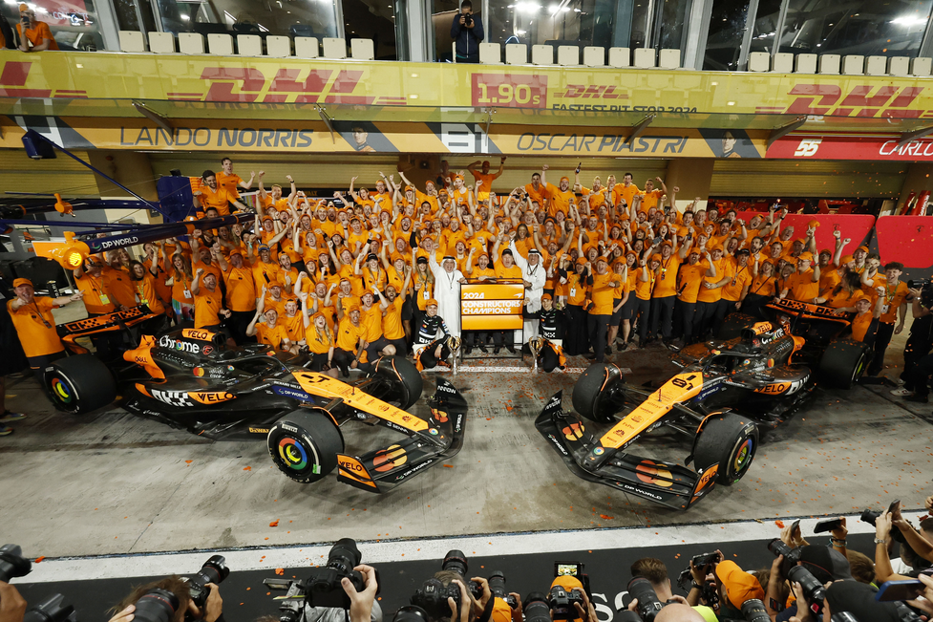
Teams, drivers and championships
Each team (constructor) fields two cars and employs two drivers.
Points are awarded based on finishing position. The driver and team with the most points at season’s end are crowned champions.
Teams compete in the Constructors’ Championship, and drivers in the Drivers’ Championship.
Source: sportingnews.com
Source: motorauthority.com

Slide 6

Cars
F1 cars are technological masterpieces, with hybrid power units combining a turbocharged V6 engine and energy recovery systems.
Made with carbon fiber, they're extremely light and fast: over 350 km/h top speed and 0 - 100 km/h in ~2.5 seconds.
Each car is designed and built by the teams within strict FIA regulations.
Source: motorionline.com

Slide 7
Why is Formula 1 fascinating?
Involves the best of engineering: aerodynamics, materials science, thermal management, mechanical design, information and electronic systems, etc.
Drivers undergo intense physical and mental training, enduring G-forces, high temperatures, and long concentration spans.
Anything can happen during a race, which is why strategy plays a crucial role (pit stops, accidents, etc.).
It’s a sport where even hundredths of a second can make the difference.

Slide 8

Why data is crucial in F1?
Each car has over 300 sensors collecting real-time data generating 1.1 million telemetry data points per second.
Data is used to:
- optimize car setup for each track.
- monitor performance and reliability.
- run simulations to test strategies .
- train drivers using advanced simulators.
Data informs race strategies: data scientists make fast decisions during the race.
Machine learning and AI are increasingly used to model race outcomes and competitor behavior.
Source: formule1fr.com

Slide 9
Project Goals

Slide 10
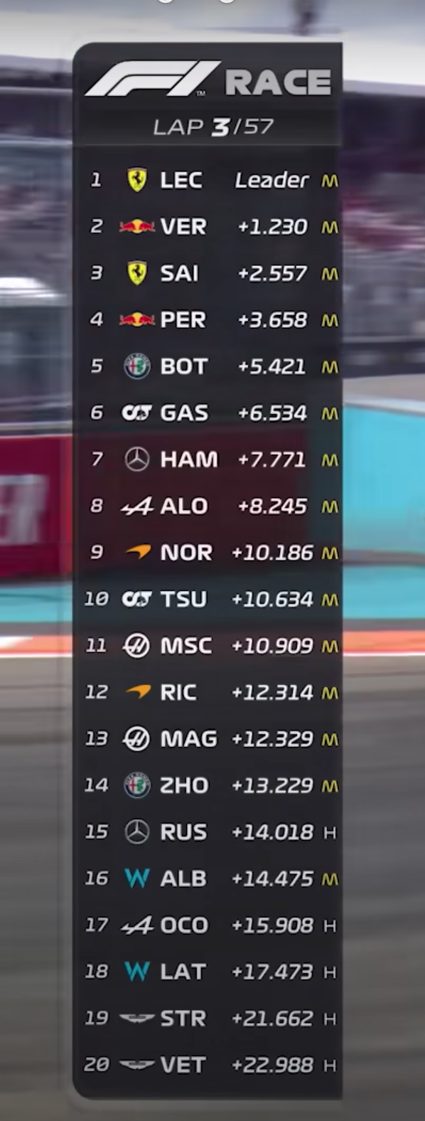
Project goals
Develop linear regression models to predict lap times based on multiple variables
Implement optimization techniques derived from gradient descent methods to minimize prediction error
Analyze model performance and interpret the influence of different factors on lap times
Source: f1friend.com

Slide 11
Why predict lap times?
Driver benchmarking: provide realistic targets based on car and track conditions.
Simulator Training: set lap time goals for driver development.
AI Calibration (Games): tune AI lap times to match real-world scenarios.
Car Development: evaluate design changes through simulated performance.
Race Strategy: support tire and fuel decisions with predicted pace.
Fan Engagement: Enhance broadcasts with expected lap time insights.

Slide 12
Data Preparation

Slide 13

Custom Dataset Construction
Pre-existing datasets on Kaggle or UCI were not suitable for my specific goal of predicting lap times under varying real-world conditions.
Instead, I created a custom dataset using the approach from a Kaggle notebook (Data Exploration with OCI), which leverages the FastF1 API (a F1 data service) to collect telemetry and race data.
The resulting dataset includes detailed lap-by-lap information from the 2023 and 2024 Formula 1 seasons.
References:
Kaggle notebook Data Exploration with OCI: link.
Code for dataset creation with FastF1 API: link.
FastF1 API documentation: link.
Source: docs.fastf1.dev

Slide 14
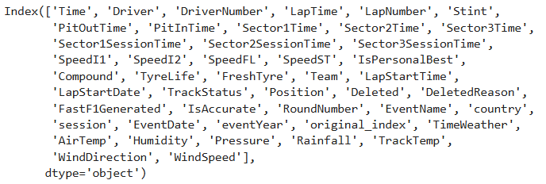
Original dataset
The result obtained using the API is a dataset (dataset_original.csv) containing 46 columns and 121 534 rows. At first glance, many of these columns appear to be irrelevant.
The code for the following operations is contained in the file 1_Dataset_Preparation.ipynb.

Slide 15
Editing rows (1/2)
Removed rows where IsAccurate is false, as they do not meet the quality criteria for valid lap data (inlap or outlap, flags, safetycar, etc.).
Removed rows in which all of the following fields were null: Stint, Compound, and TyreLife.
Excluded drivers with minimal or unofficial participation.
Removed laps recorded under yellow flag conditions (i.e., where TrackStatus ≠ 1).
Excluded free practice sessions (FP1, FP2, FP3).

Slide 16
Editing rows (2/2)
Removed warm-up laps in qualifying sessions, retaining only laps within 5 seconds of the driver's best time in the same session.
Standardized team names (Alfa Romeo → Kick Sauber, AlphaTauri → RB).
Removed unofficial tyre compounds like test compound.
Converted LapTime to seconds

Slide 17
Editing columns
Dropped unnecessary columns at the beginning: DriverNumber, Sector1Time, Sector2Time, Sector3Time, Sector1SessionTime, Sector2SessionTime, Sector3SessionTime, SpeedI1, SpeedI2, SpeedFL, SpeedST, IsPersonalBest, LapStartTime, LapStartDate, Position, DeletedReason, FastF1Generated, Country.
Added a new column FuelLevel based on estimated fuel consumption per lap.
Dropped additional columns after filtering and row operations: IsAccurate, PitOutTime, PitInTime, TrackStatus, Deleted, EventDate, Time, Stint, RoundNumber, TimeWeather, original_index.

Slide 18
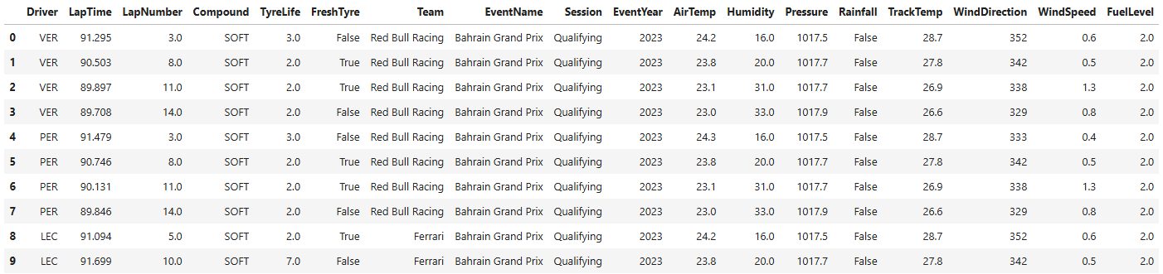
Final dataset
The new data have been exported to the file dataset_final.csv.
Changes include:
columns: 46 → 18;
rows: 121 534 → 52 160.

Slide 19
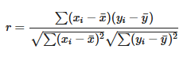
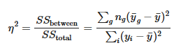
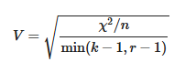
Analysis of correlations between variables
Numerical vs numerical variable: Pearson correlation coefficient (from -1 to 1)
Categorical vs numerical variable: Eta squared (from 0 to 1)
Categorical vs Categorical variable: Cramér V (from 0 to 1)

Slide 20
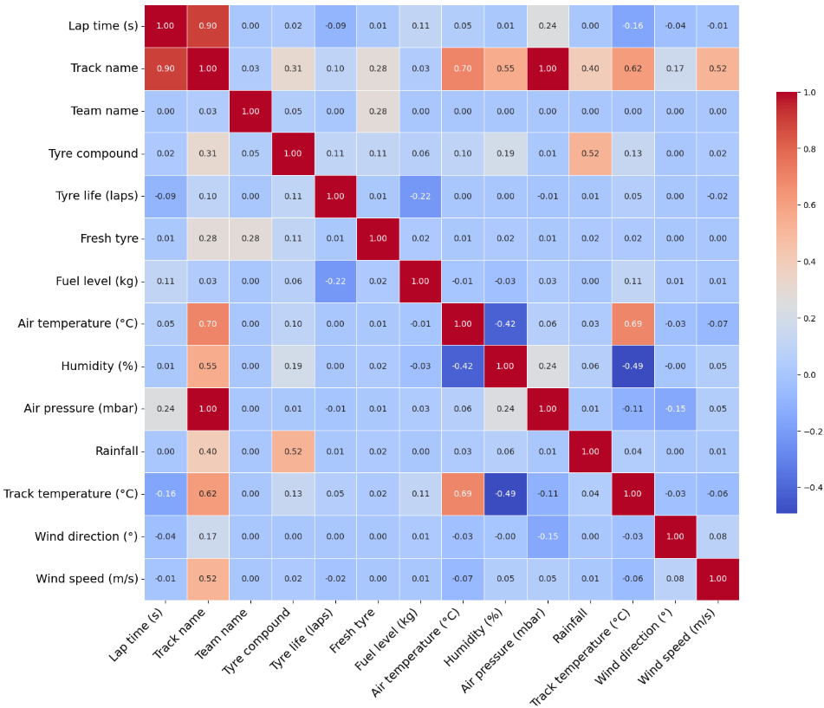
Correlation matrix
Lap times are highly correlated with the circuit.
Air pressure is excessively correlated with the circuit, while variables such as air temperature and humidity convey overlapping information.
Therefore, air pressure, air temperature, and humidity will not be included in the model.

Slide 21
Model creation

Slide 22
La memoria a disposizione del programmatore è suddivisa in 2 macro-aree:
Memoria del codice, contenente il codice sorgente da eseguire
Memoria dei dati, la quale si evolve con il programma, divisa in:
Stack (LiFo): dimensione fissa, contiene variabili, parametri e indirizzi di ritorno
void example() {
int x = 10; // 'x' is stored in stack memory
} // 'x' is deallocated automatically when the function ends
{ //Imagine you are in the main method...
int x = 10; // 'x' is stored in stack memory
}
// 'x' is deallocated automatically when we leave the block

Slide 23
Key-points della teoria: La memoria
La memoria a disposizione del programmatore è suddivisa in 2 macro-aree:
Memoria del codice, contenente il codice sorgente da eseguire
Memoria dei dati, la quale si evolve con il programma, divisa in:
Heap (FiFo): usata per l’allocazione dinamica dei dati; gestita dal programmatore; usata per contenere strutture dati di grandi dimensioni (oggetti, array, …)
void example() {
int* ptr = new int(10); // Memory for the integer is allocated on the heap
delete ptr; // The programmer is responsible for freeing the memory
}
Notes:
Puntatori sono salvati sullo STACK e puntano a un’area di memoria sull’HEAP

Slide 24
Key-points della teoria: Initializer list
Permettono di eseguire delle operazioni prima che il codice nel costruttore venga eseguito;
Usate per inizializzare attributi della classe prima che questa sia creata;
L’ordine di inizializzazione degli attributi segue l’ordine in cui sono stati definiti e non quello della initializer list.
class PinoPasticcino {
Public:
int a; // Variabile sullo stack
int& b; // Reference
const int c; // Costante
PinoPasticcino(int x, int& y, int z) : a(x), b(y), c(z) {
// Constructor body
}
};
Notes:
Perchè usarle?

Slide 25
Key-points della teoria: Initializer list
Talvolta sono necessarie:
Vogliamo inizializzare un attributo sullo stack che non dispone di un costruttore di default;
Dobbiamo inizializzare un attributo che è una reference;
Stiamo costruendo una sottoclasse e vogliamo usare un costruttore della superclasse che non sia quello di default;
Quando stiamo inizializzando dei const members.
Talvolta sono facoltative:
Vogliamo inizializzare un attributo sullo stack avente un costruttore di default;
Dobbiamo inizializzare un attributo che è un puntatore…
Notes:
Perché dovrei volerle usare?
Pulizia e ordine
Migliori prestazioni
Stile di programmazione etc.

Slide 26
Domandine?

Slide 27
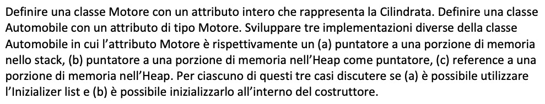
Esercizio 1/2
Notes:
Struttura classica richiede di implementare una classe con un attributo in 3 modi diversi

Slide 28
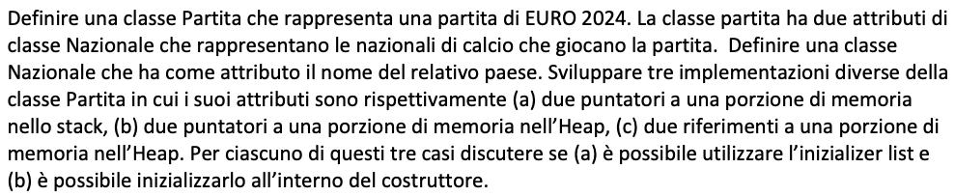
Esercizio 2/2
Notes:
Essenzialmente uguale al primo se non che cambiano i nomi

Slide 29
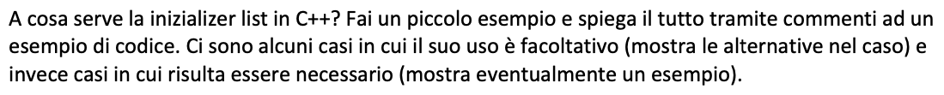
Esercizio Extra

